Slide 1
Email Classification
NLP
Steven Kusuma - FTDS Batch 015

Slide 2
Table Of Content
Objective and Model
2. Dataset
3. Exploratory Data Analysis
4. Text Preprocessing
5. Model Evaluation
6. Sample Testing

Slide 3
Objective
Model
An Artificial Neural Network Model to detect that an email is a Spam or Not Spam.
Natural Language Processing (NLP)

Slide 4
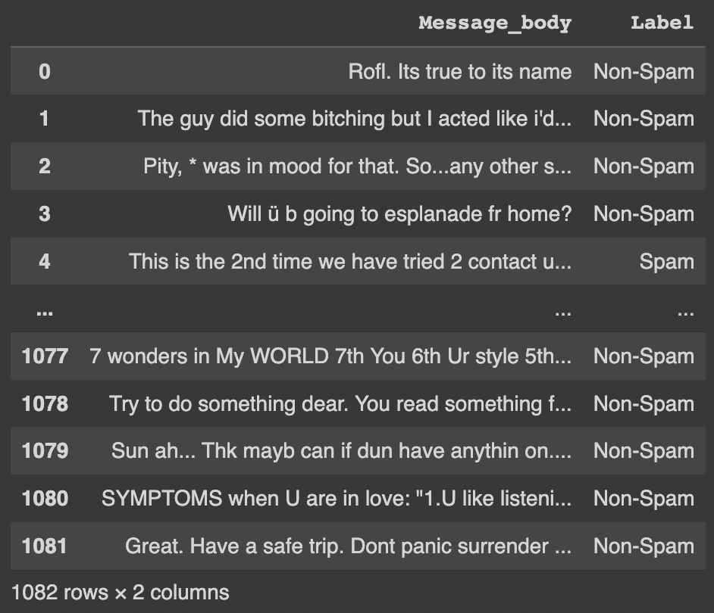
Dataset
Data consists of 1,082 rows and 2 columns, all are strings.
https://www.kaggle.com/datasets/datatattle/email-classification-nlp

Slide 5
Exploratory Data Analysis

Slide 6
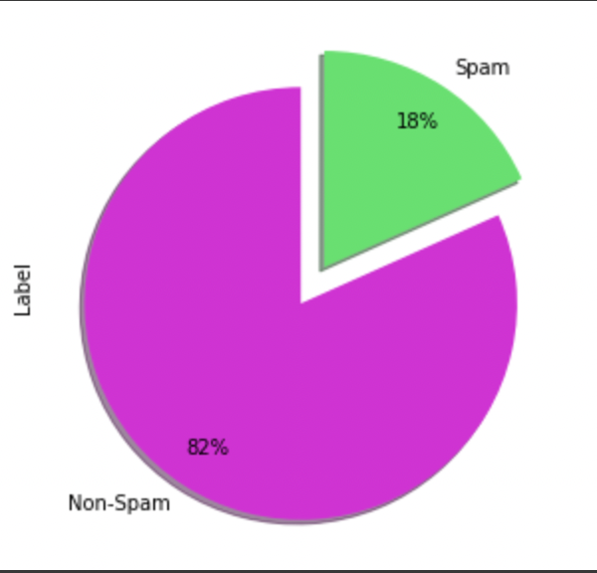
Data Spread

Slide 7
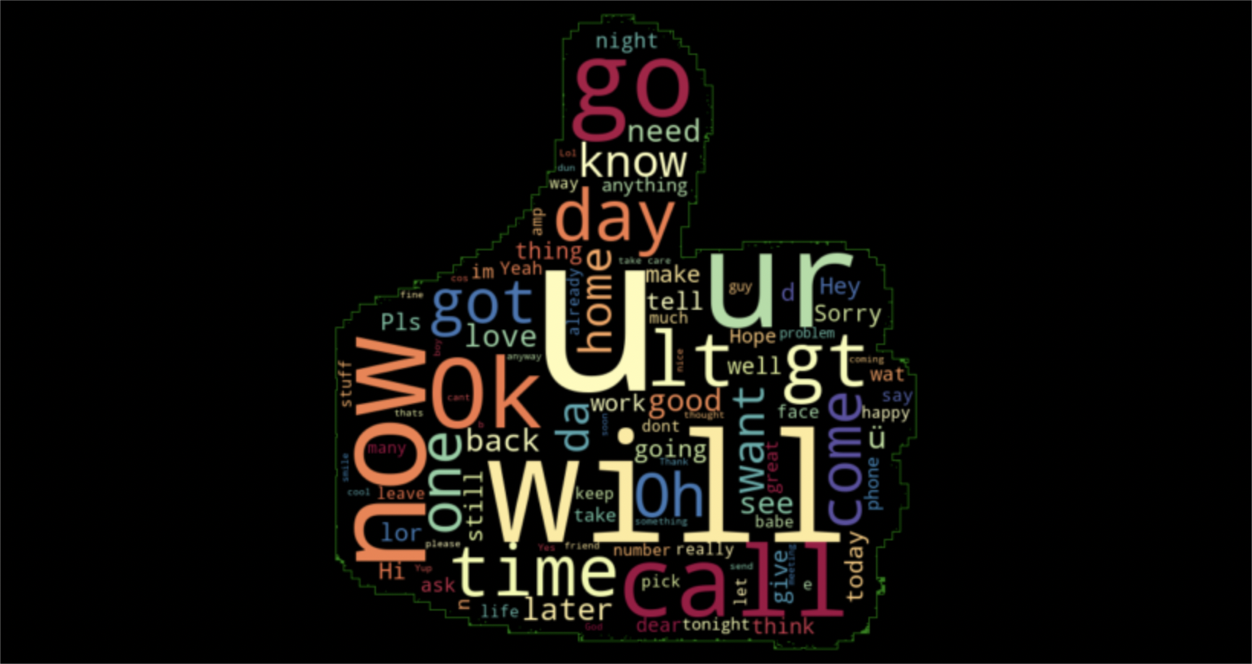
WordCloud ( Non-Spam Email )

Slide 8
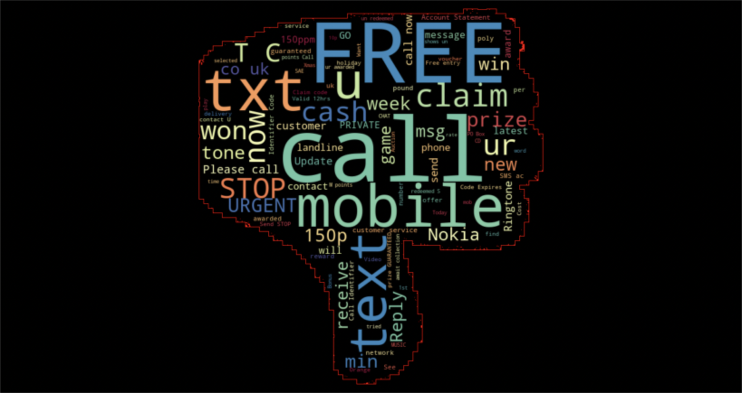
WordCloud ( Spam Email )

Slide 9
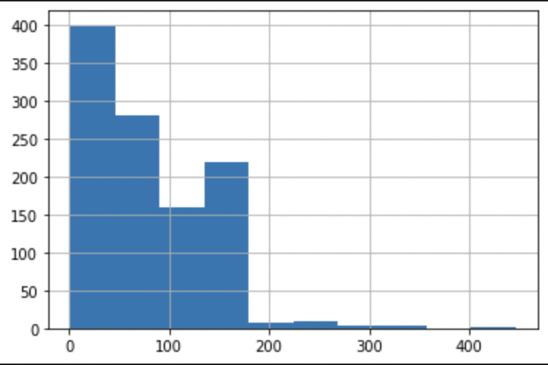
Characters Spread

Slide 10
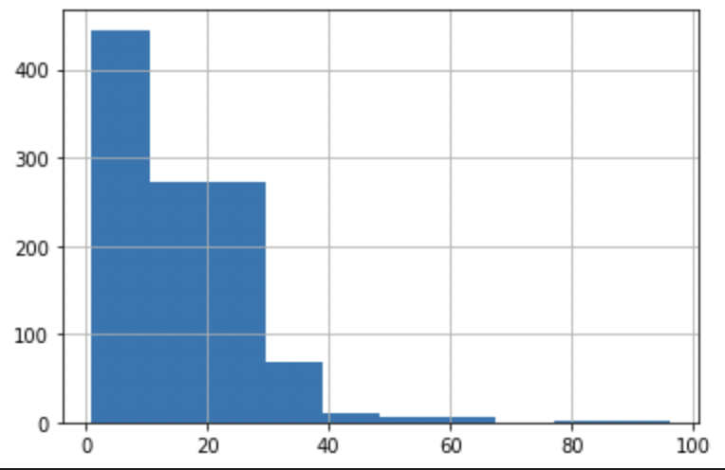
Words Spread

Slide 11
Text Preprocessing
Change All Text to Lowercase
2. Removing Mentions
3. Removing Hashtags
4. Removing New Lines
5. Removing White Spaces
6. Removing Links
7. Removing Non Text Characters
8. Removing RT ( Retweets )
9. Tokenization
10. Removing Stopwords
11. Stemming

Slide 12
Model Evaluation

Slide 13
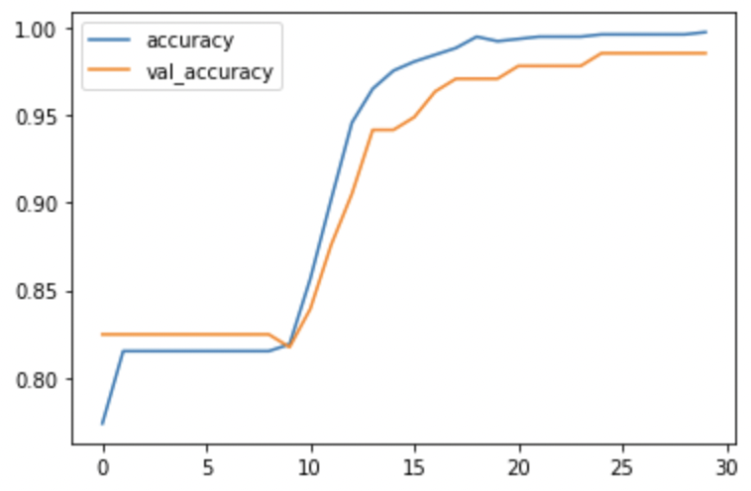
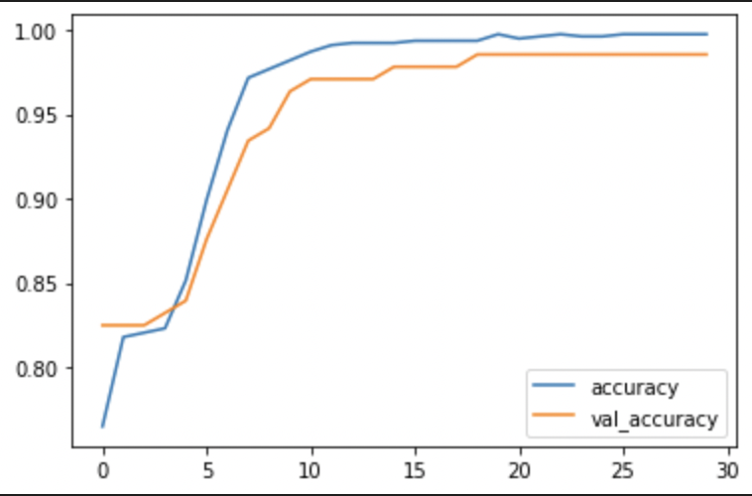
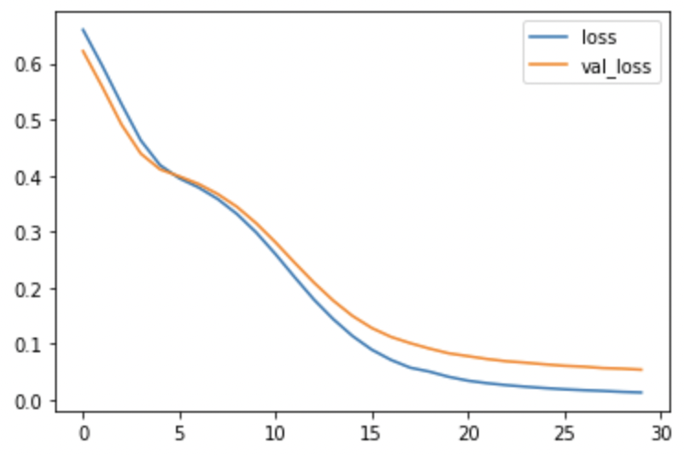
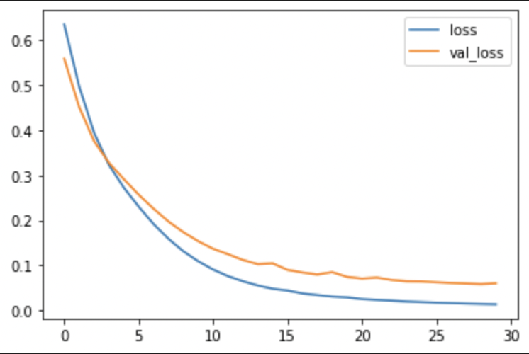
Sequential API
Baseline
442,277 Parameters
Adam
Improvement
442,277 Parameters
Nadam
Accuracy
Loss

Slide 14
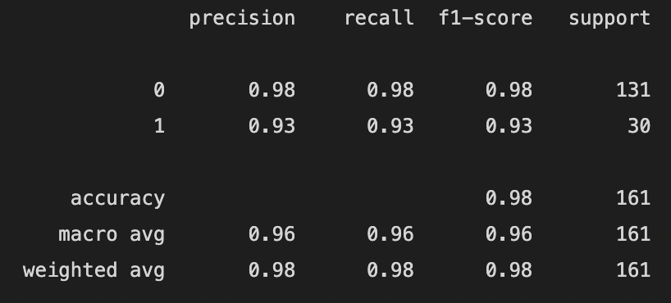
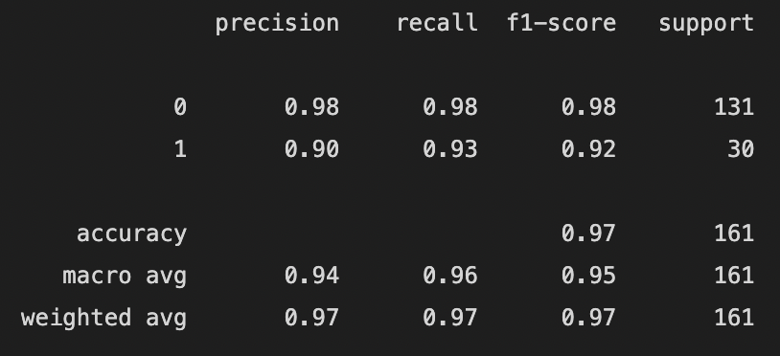
Classification Report
Baseline
Improvement

Slide 15
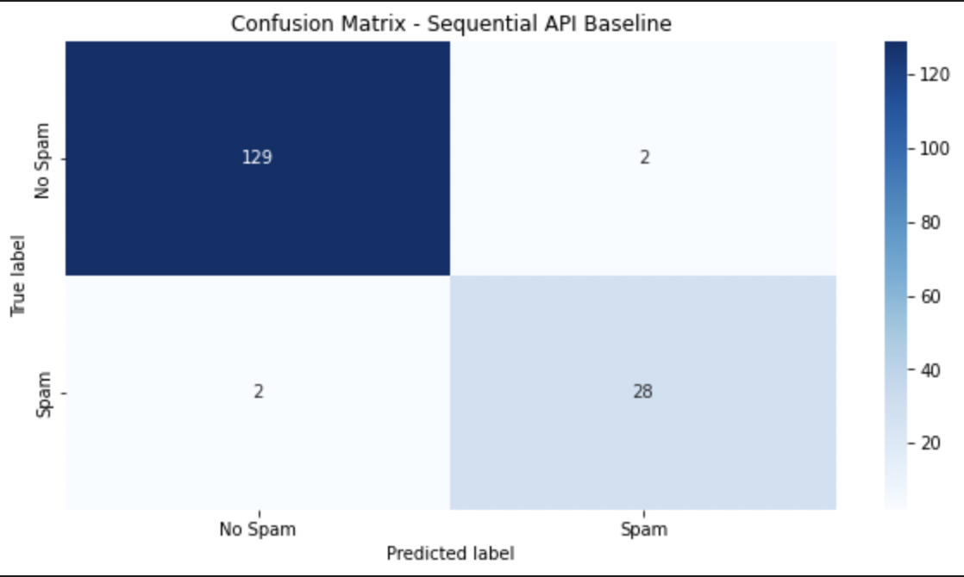
Baseline Model
Test Accuracy level : 98%
This model predicts Non-Spam target correctly by 98%
The main concern is as if :
True label = No Spam
Predicted label = Spam
as a result might not be responding to the email.

Slide 16
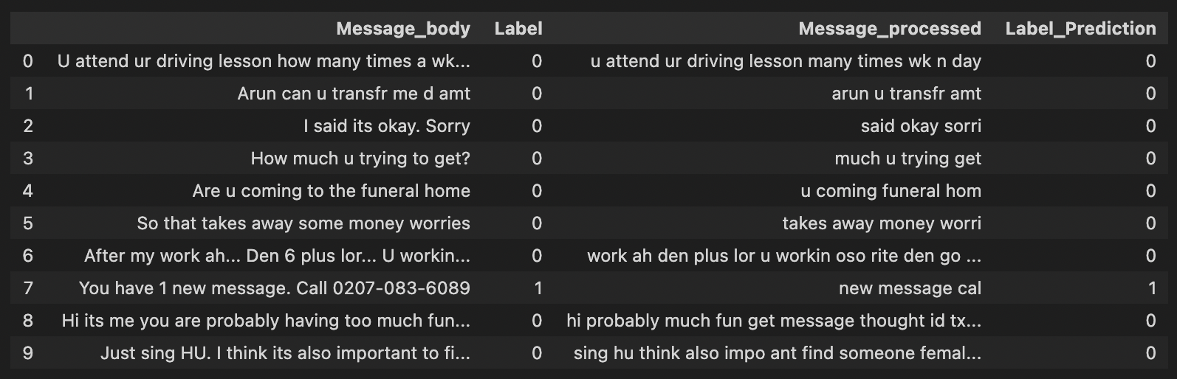
Sample Testing using Best Model
All sample correctly predicted using Best Model.
True Label
Predicted Label

Slide 17

Thank you!

